Slide 1
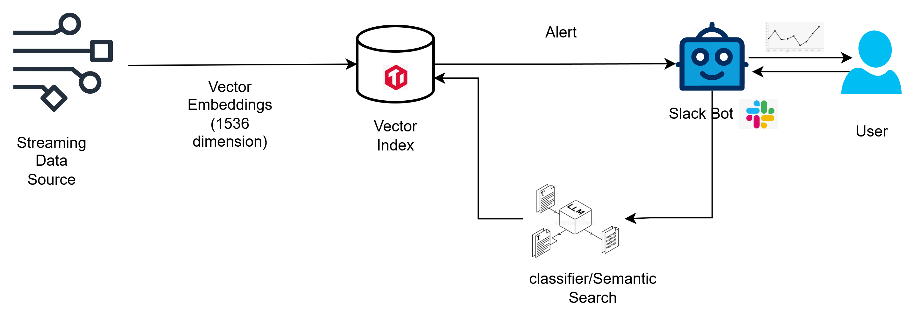
Design Architecture
Data Ingestion
Anomaly Detection
User Interaction via Slack Bot
Query Processing & Response
Sensor readings are simulated using a Python script to mimic a live streaming dataset
Data is continuously ingested into TiDB for storage and processing
Each record is transformed into an embedding vector of 1536 dimensions to capture semantic meaning
A vector index (HNSW) is created to enable efficient similarity searches using VEC_COSINE_DISTANCE
Incoming sensor records are validated against predefined bootstrap rules
Records that meet the anomaly criteria are inserted into a dedicated Anomalies table in TiDB
Insertion into the anomalies table immediately triggers an alert notification in Slack
New incoming records are compared with stored anomalies using cosine distance
If similarity threshold < 0.2, the event is flagged as related and another alert is sent via Slack
A Slack bot provides a natural interface for users to interact with the system
Users can request visualizations, KPIs, and data-driven insights directly in Slack
Queries are classified by an LLM into different types:
Semantic queries (requiring vector-based similarity search)
Direct SQL queries (executed against TiDB for structured results)
This makes the system accessible without needing technical knowledge of SQL or database structures
For semantic queries:
User request is converted into embeddings using a text embedding model
These embeddings are compared against stored vectors in TiDB using cosine distance
For direct SQL queries:
Query is executed against TiDB tables for precise retrieval
The final results are formatted and returned to Slack as:
Charts or visual graphs for data exploration
Numeric KPI values for quick decision-making

